Slide 1
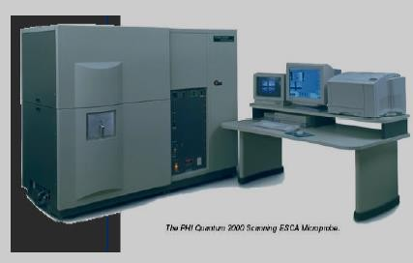
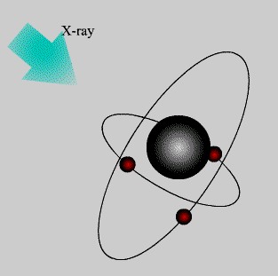
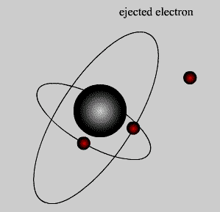
X-ray Photoelectron Spectroscopy
Electron Spectroscopy for Chemical Analysis (ESCA)
XPS 란?
방출되는 광전자의 에너지를 통해 결합상 태 및 원소를 분석하는 방법
스웨덴의 물리학자 K. Siegbahn에 의하여
개발됨 - 전자 분광법(ESCA) 라고도 부름
XPS 원리
특정 에너지를 가진 X-ray을 시편에 조사하면
시편에서 전자들이 방출되는데, 이때 전자
들의 운동에너지를 측정하면, (원자들의
Bind energy를 통해) 시편의 원소를 알 수 있음.
K.E = hυ – B.E
(K.E : 운동에너지 , B.E : 결합에너지)

Slide 2
What is XPS ?
X-ray Photoelectron Spectroscopy (XPS)
Electron Spectroscopy for Chemical Analysis (ESCA)
XPS, also known as ESCA, is the most widely used surface analysis technique because of its relative simplicity in use and data interpretation. The sample is irradiated with mono-energetic x-rays causing photoelectrons to be emitted from the sample surface. An electron energy analyzer determines the binding energy of the photoelectrons. From the binding energy and intensity of a photoelectron peak, the elemental identity, chemical state, and quantity of an element are determined. The information XPS provides about surface layers or thin film structures is of value in many industrial applications including: polymer surface modification, catalysis, corrosion, adhesion, semiconductor and dielectric materials, electronics packaging, magnetic media, and thin film coatings used in a number of industries. Specific applications include: surface elemental and chemical characterization, thin film characterization, surface cleanliness, and surface migration of additives or impurities.

Slide 3
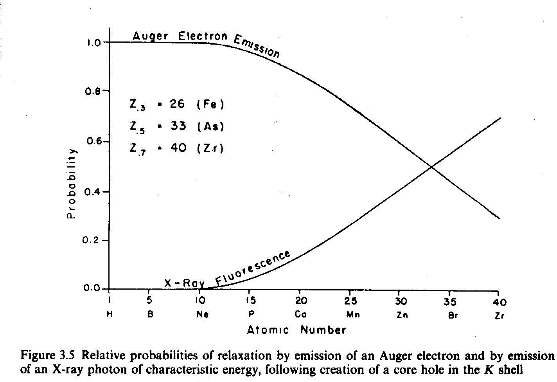
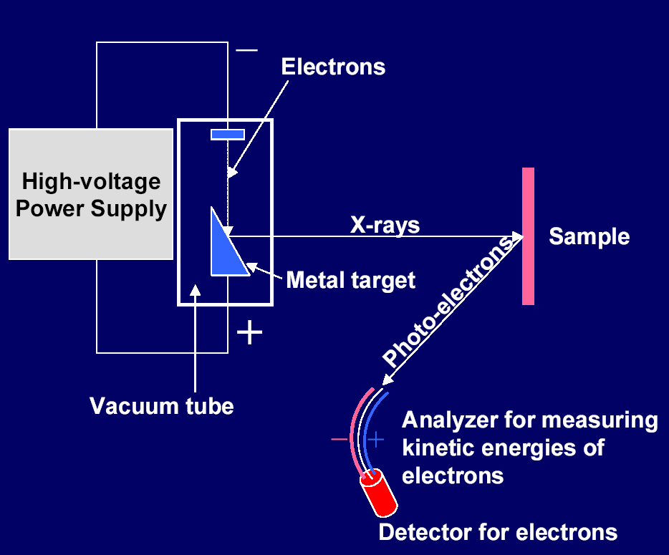
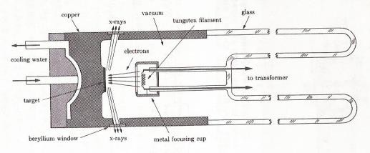

Slide 4
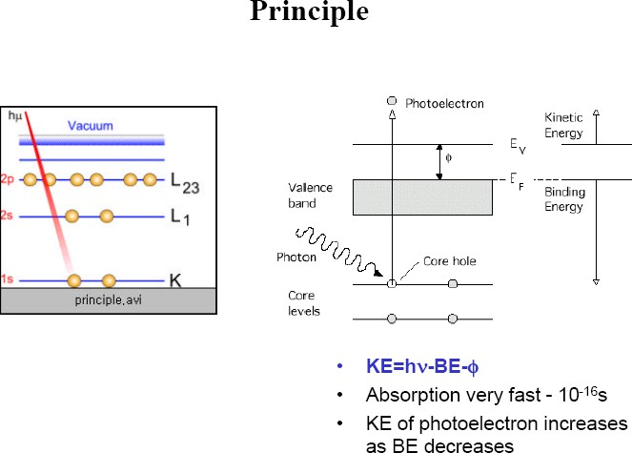

Slide 5
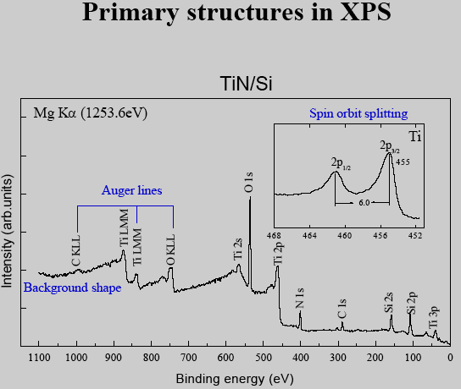

Slide 6
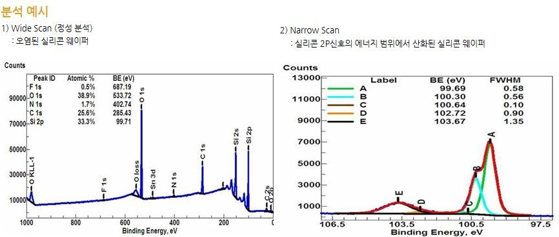
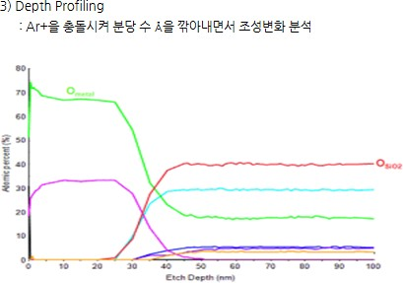

Slide 7
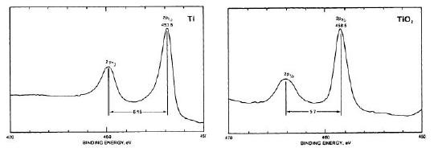
DLC, XPS 분석 - SP3 분율
The deconvolution of C 1s peak
3.0x10⁴
29.9%
Magnetron (800 V)
59.2%
70.2%
2.5x10
4
3
500 eV
800 eV
29.9% sp
59.2% sp³
Intensity (arbitrary unit)
70.2% sp
3
Intensity (a.u)
2.0x10⁴
1.5x10⁴
1.0x10⁴
5.0x10³
0.0
Intensity (a.u)
280
282
284 286
Binding Energy (eV)
288
290
280
282
284 286
Binding Energy (eV)
288
290
280
282
284 286
Binding Energy (eV)
288
290
XPS 분석 – Chemical Shift analysis

